Slide 1


Quantum Enhanced
Reinforcement Learning
Quantum Machine Learning course Seminar
Speaker: Simone Caldarella

Slide 2
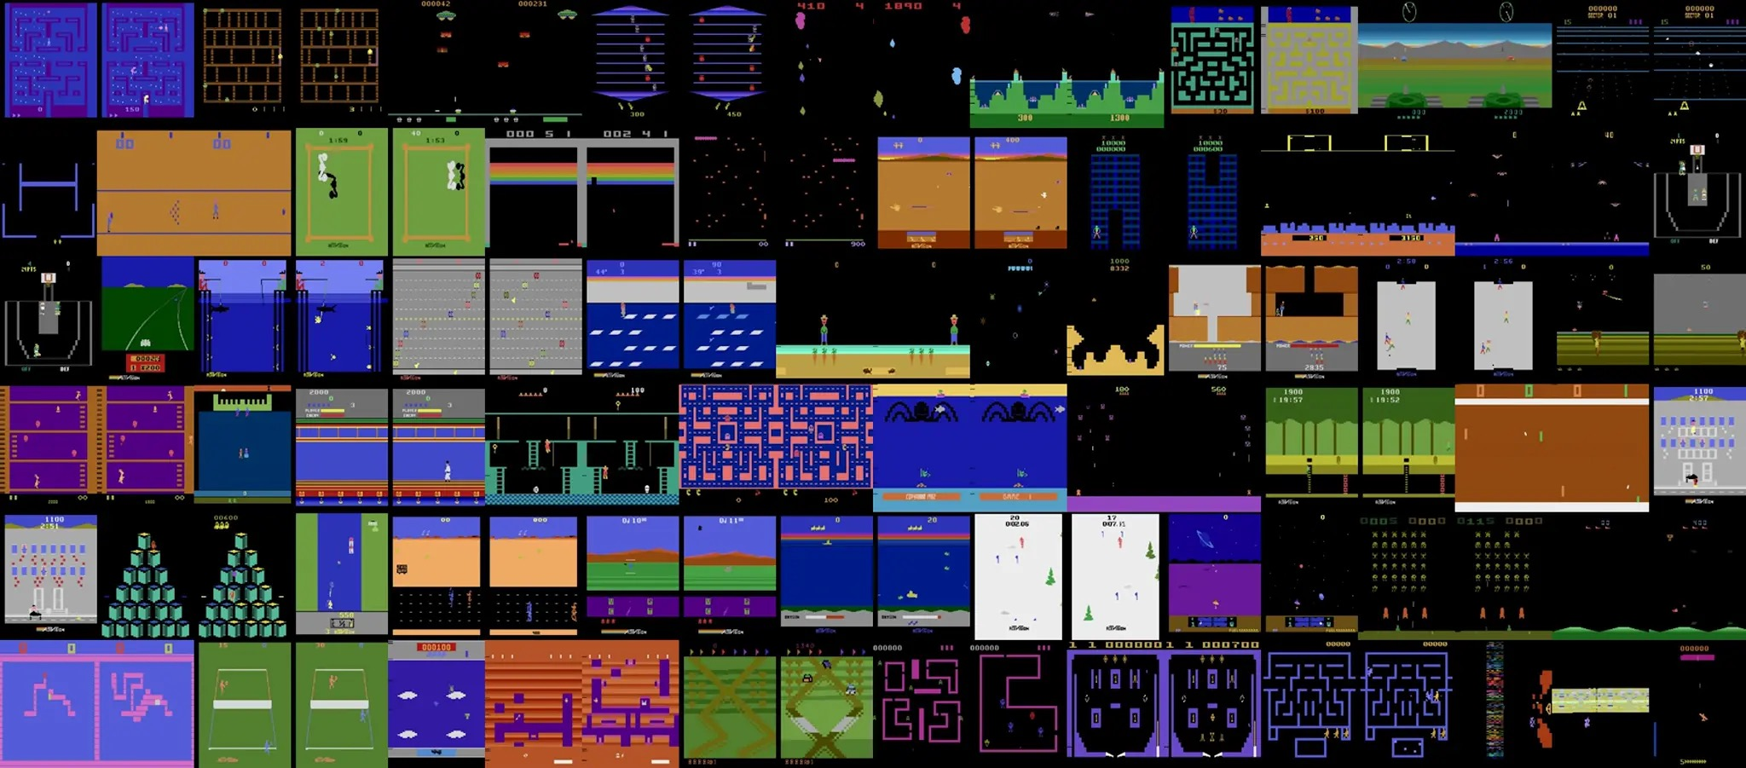
Motivation
Simone Caldarella | 223343

Slide 3

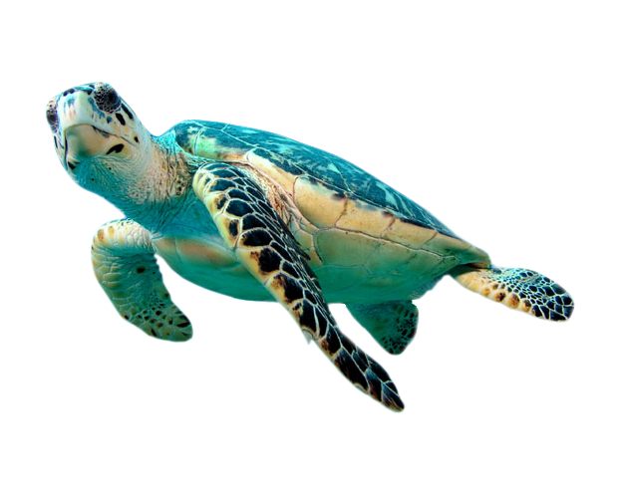
Motivation
Magic Box

Slide 4
Agenda
Reinforcement Learning
Introduction
Markov Decision Process
Value Function
Example
Quantum Computing
Introduction
Qubit and Superposition
Quantum Circuit
Grover Algorithm
Quantum Enhanced Reinforcement Learning
Setting
Implementation
Results

Slide 5
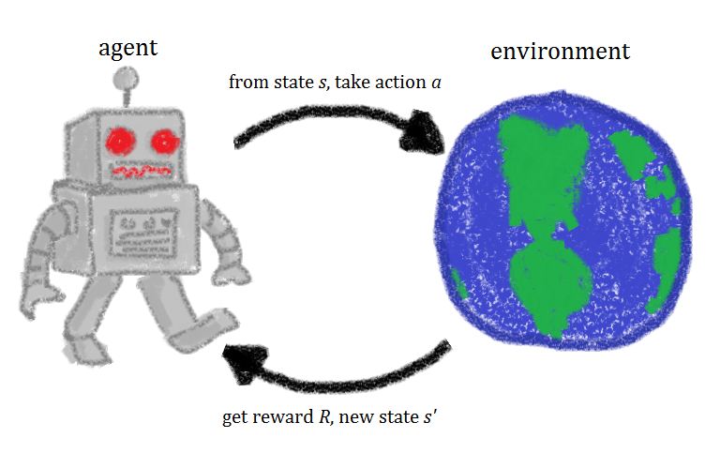
Reinforcement Learning

Slide 6
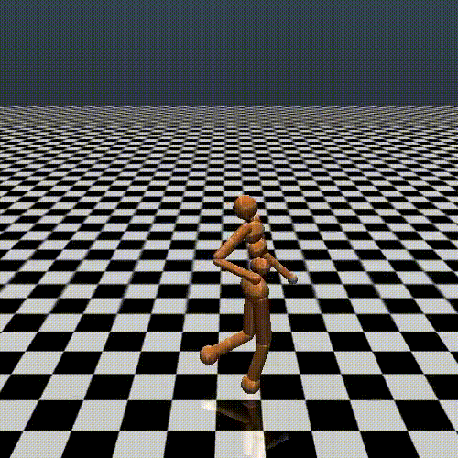
Introduction
What is Reinforcement Learning?
The process of learning what to do at a certain moment to maximize a numerical reward signal
Alternative Machine Learning Paradigm
Similarly to nature implies an evolution based on evaluative feedbacks provided by the environment
No right or wrongs choices, just better or worse ones
When is it used?
No explicit solution can be found
No absolute better action can be taken
Discover is required to be a part of the learning
Expensive labels, cheap rewards

Slide 7
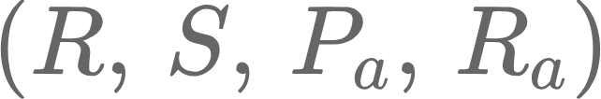


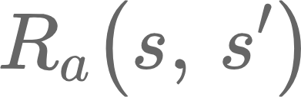
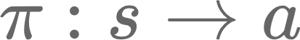
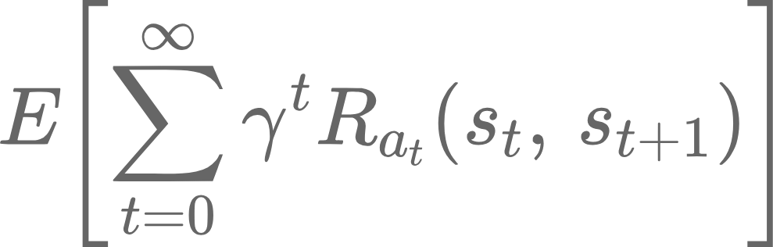
Markov Decision Process
A Markov Decision Process is a 4-dim tuple :
→ a finite state space
→ a finite actions space
→ transition probabilities
→ instant reward
The main goal is to find an optimal policy in the given environment, by maximizing the expected future rewards in a potentially infinite process:

Slide 8
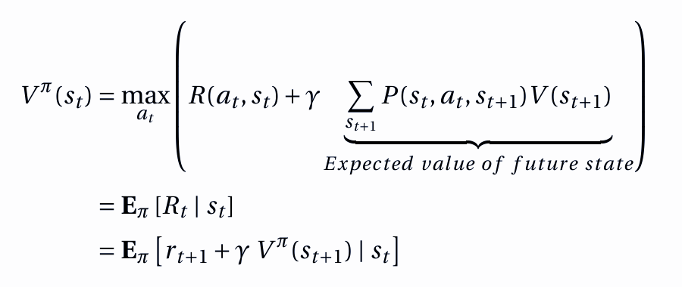
Value Function

Slide 9
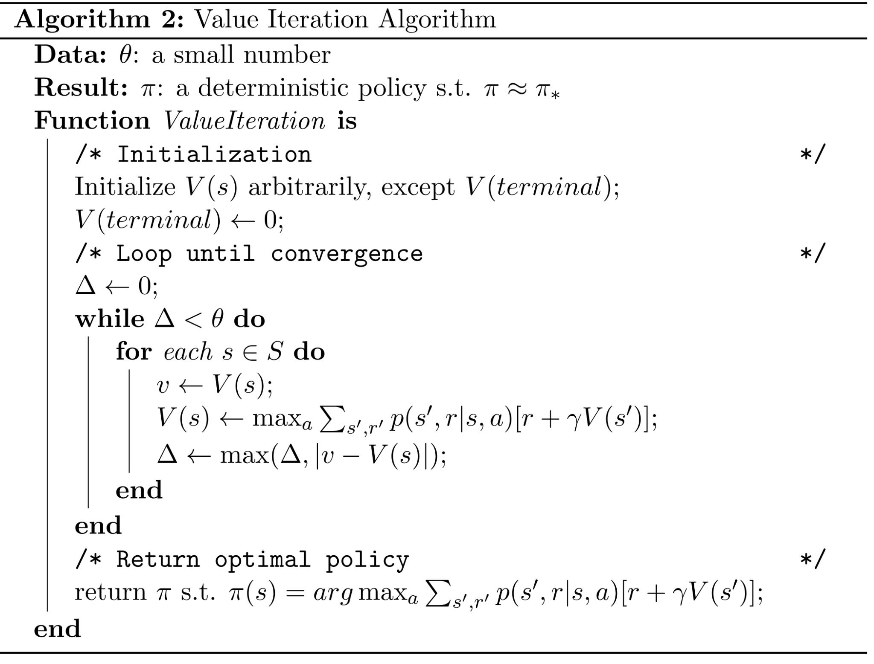
Value Function - Iteration

Slide 10
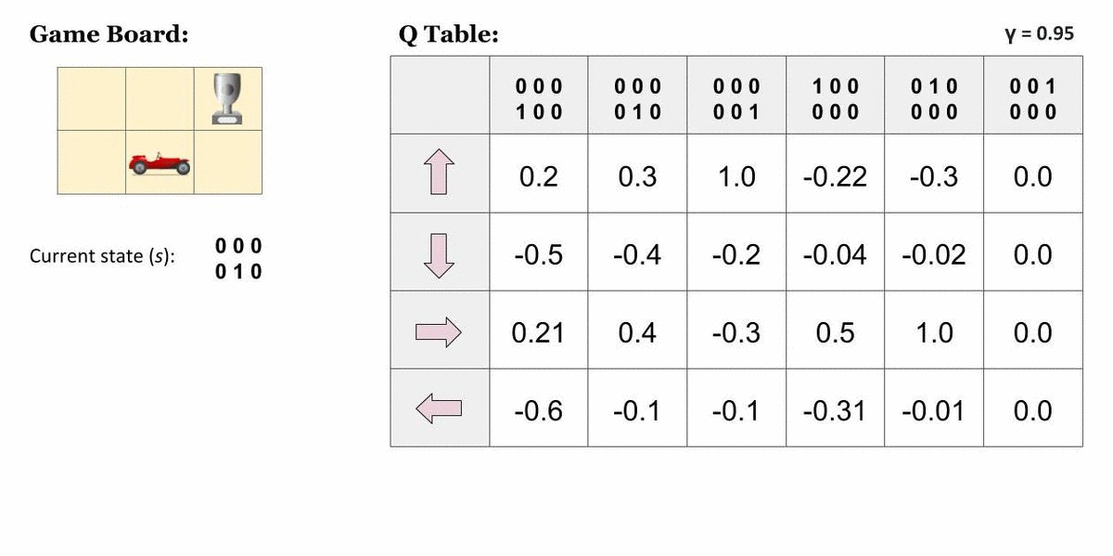
Example

Slide 11
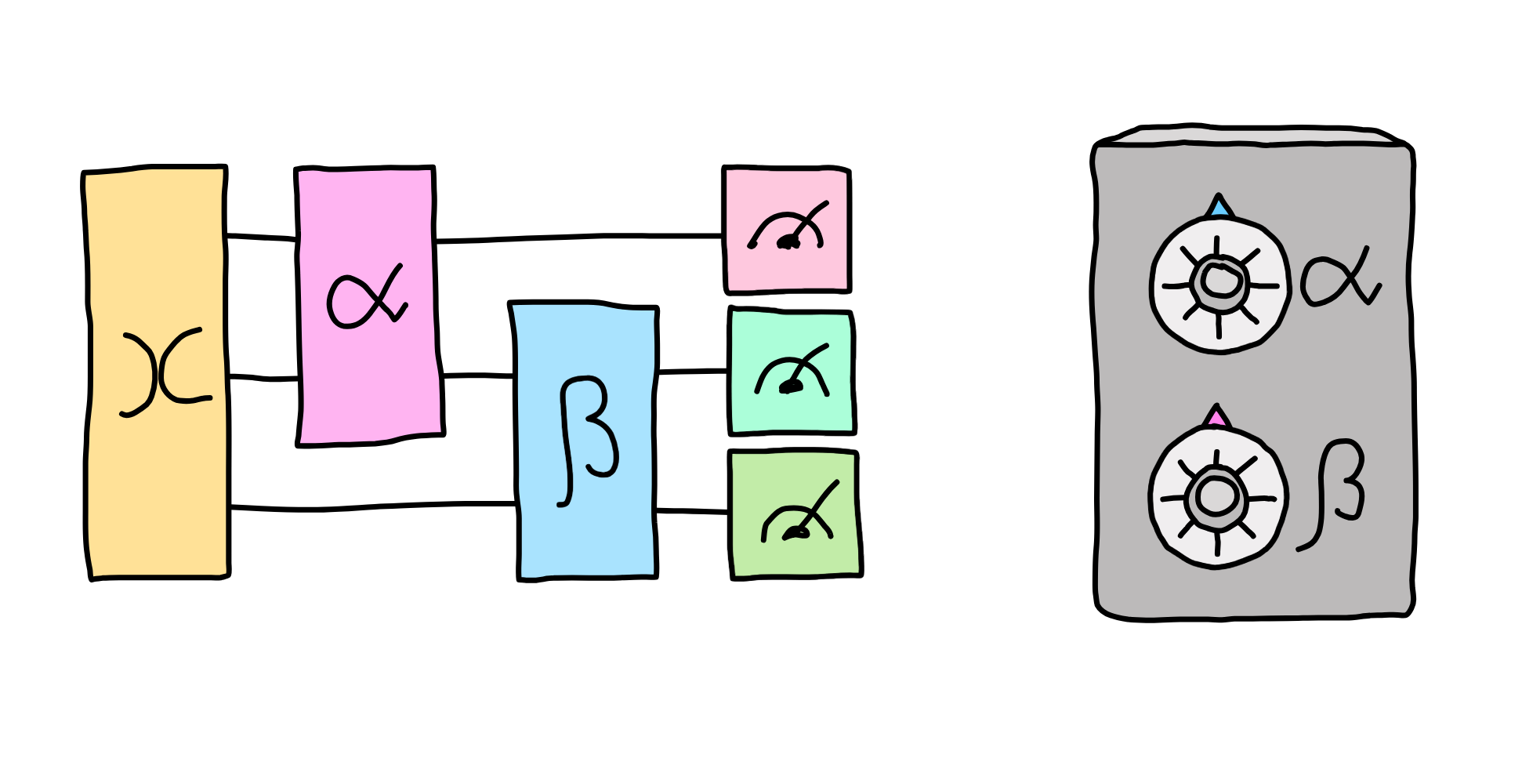
Quantum Computing

Slide 12
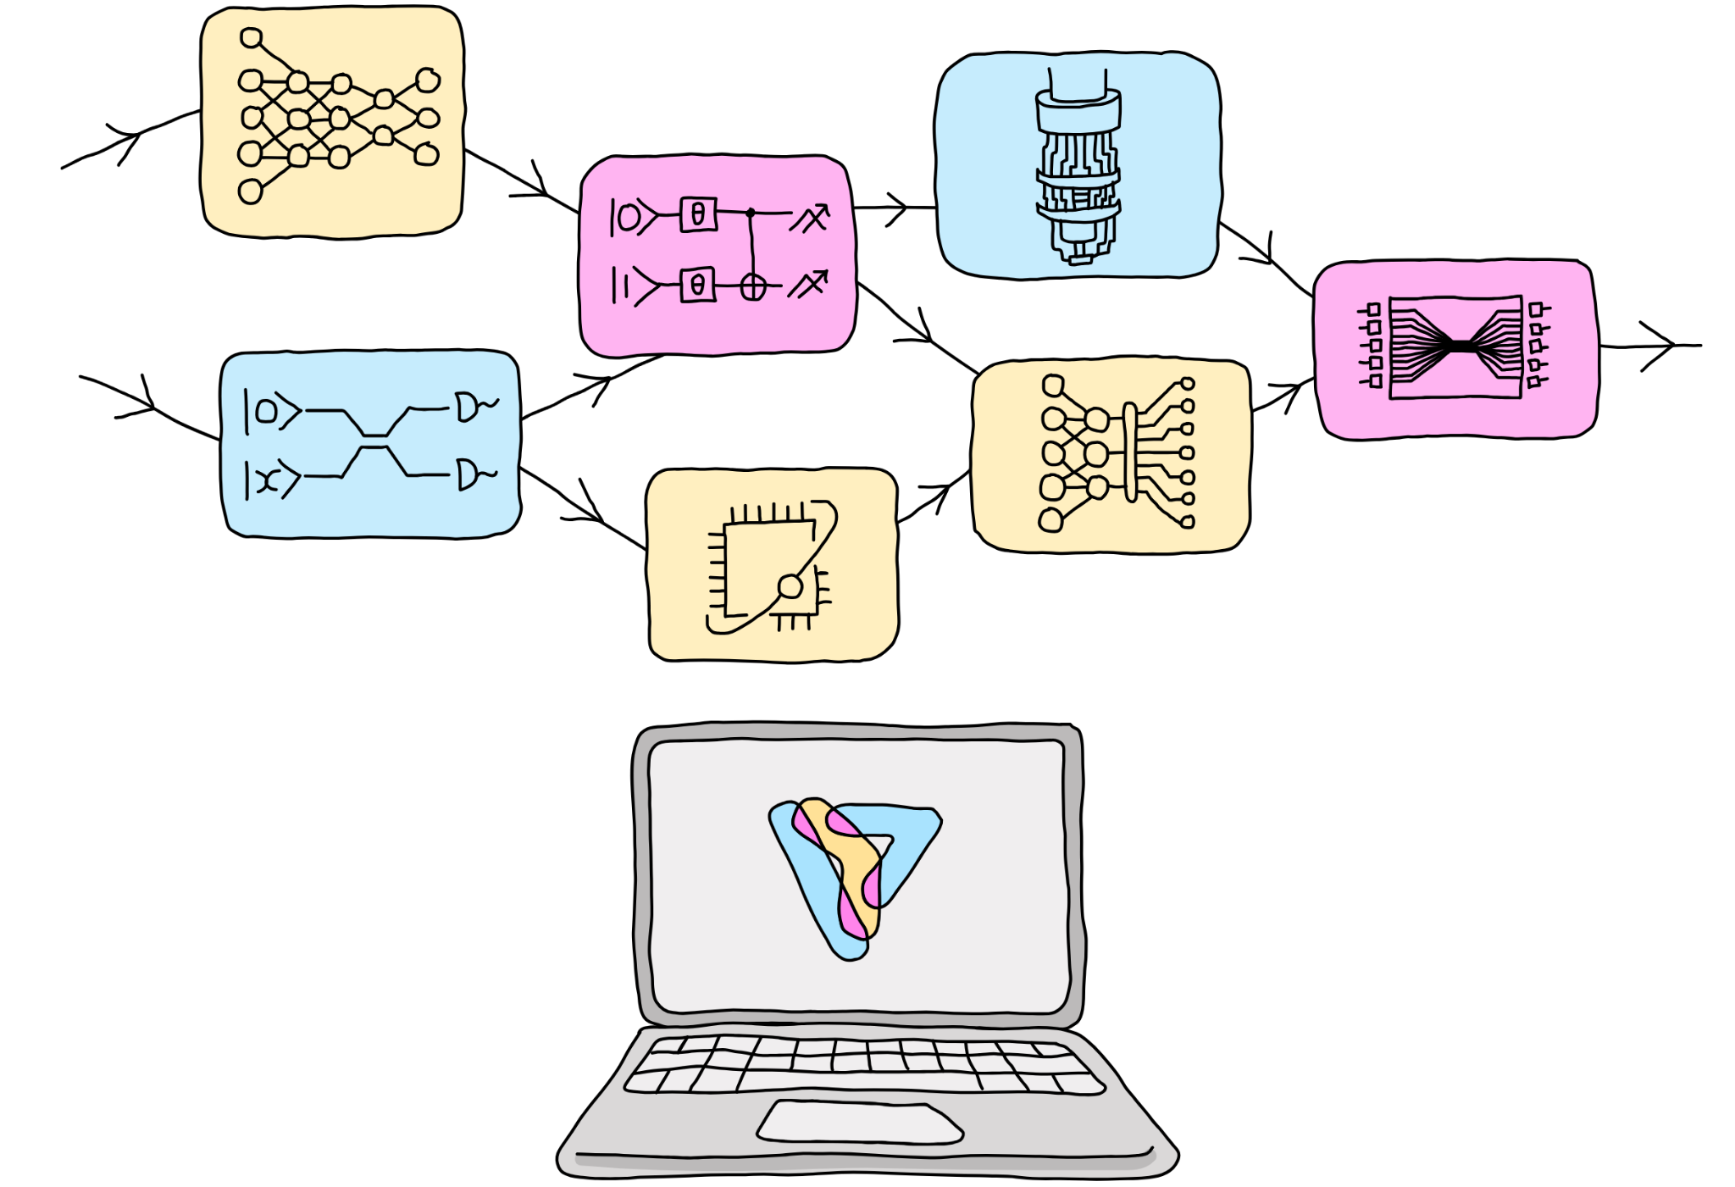
Introduction
Quantum computing expands classical computers' capabilities by harnessing quantum properties in the physical world
Leveraging quantum properties to speed-up classical algorithms
Main challenges are scalability and fault tolerance

Slide 13
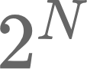
Qubits and Superposition
Qubit vs Cbit
Bit (Cbit) is just a discrete binary representation
Given N bit we can represent different states
Qubit can embed the same number of states, however thanks to the superposition of states, all of these states exists at the same time and can be processed together
Superposition
Fundamental property of quantum mechanics for which multiple states of a particle exists together with a degree of probability
Superposition property derives by the double nature of small “objects” that behave both as waves and particles
Quantum operations acting on more states happen only in the unobserved theoretical Hilbert Space → when the state is observed it collapse into a single state behaving as a non quantum particle

Slide 14
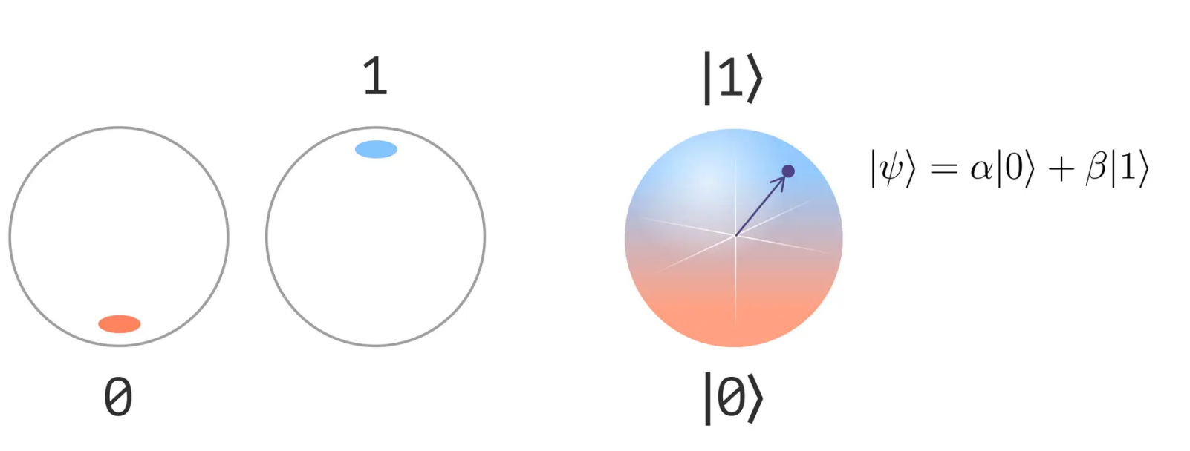
Qubits and Superposition

Slide 15
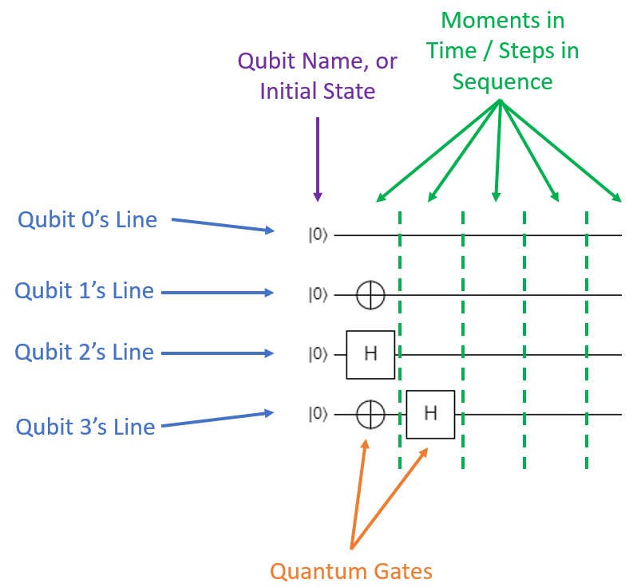
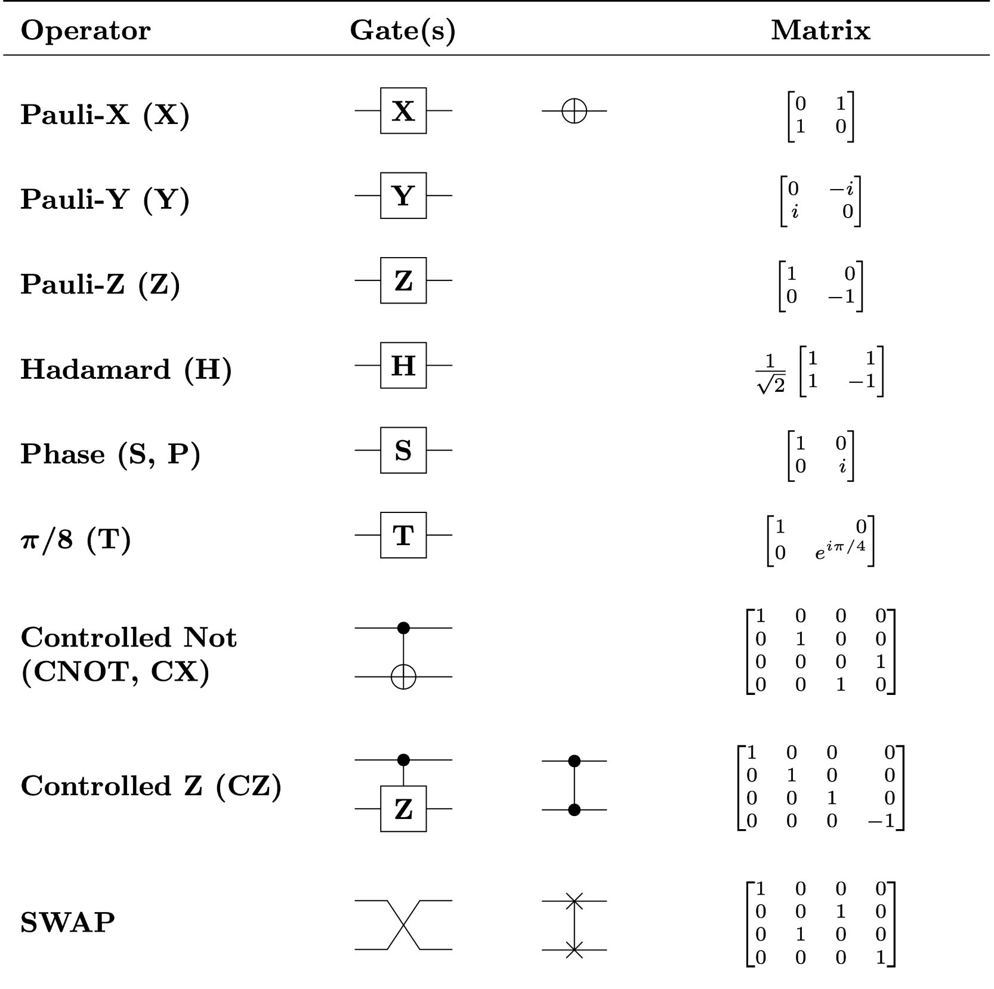
Quantum Circuit

Slide 16
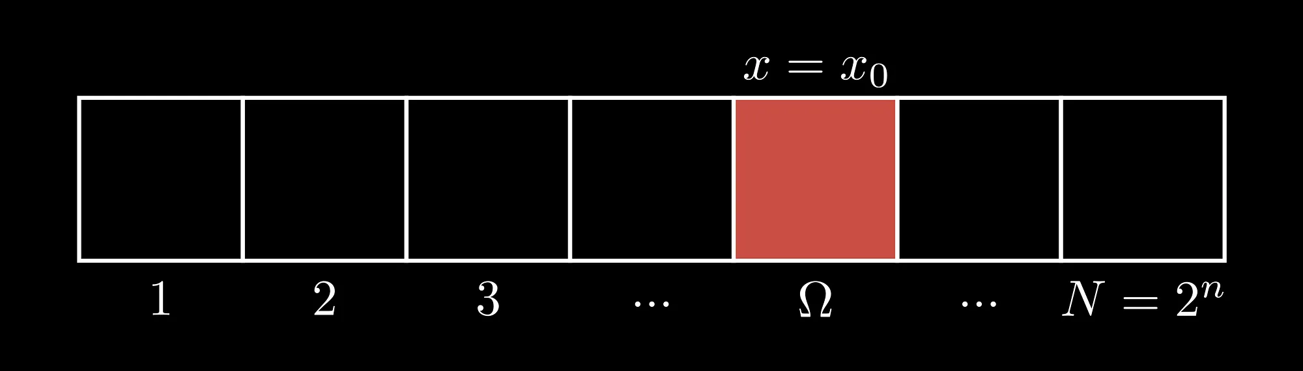
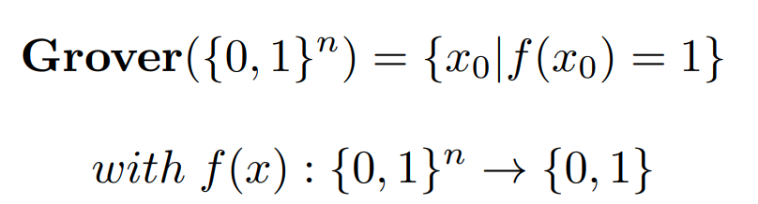
Grover Algorithm - Problem Statement
Given an unsorted database of N items, how can we efficiently find a specific item with only a few queries to the database?

Slide 17
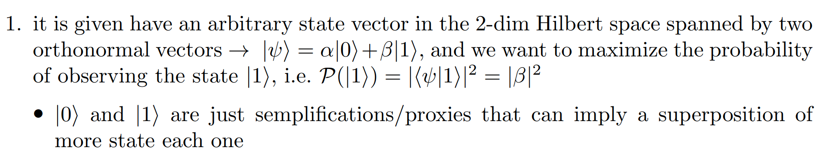
Grover Algorithm - Problem Statement

Slide 18
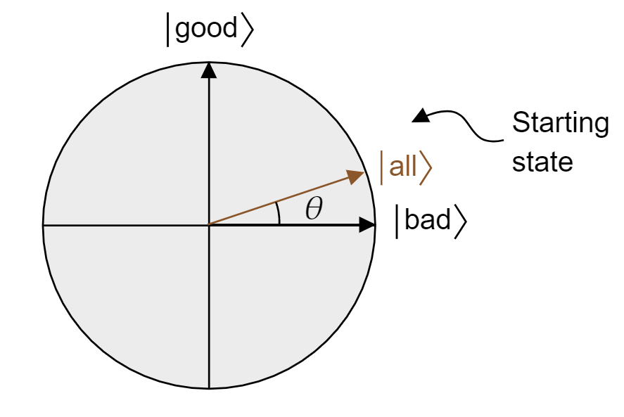
Grover Algorithm - Problem Statement

Slide 19
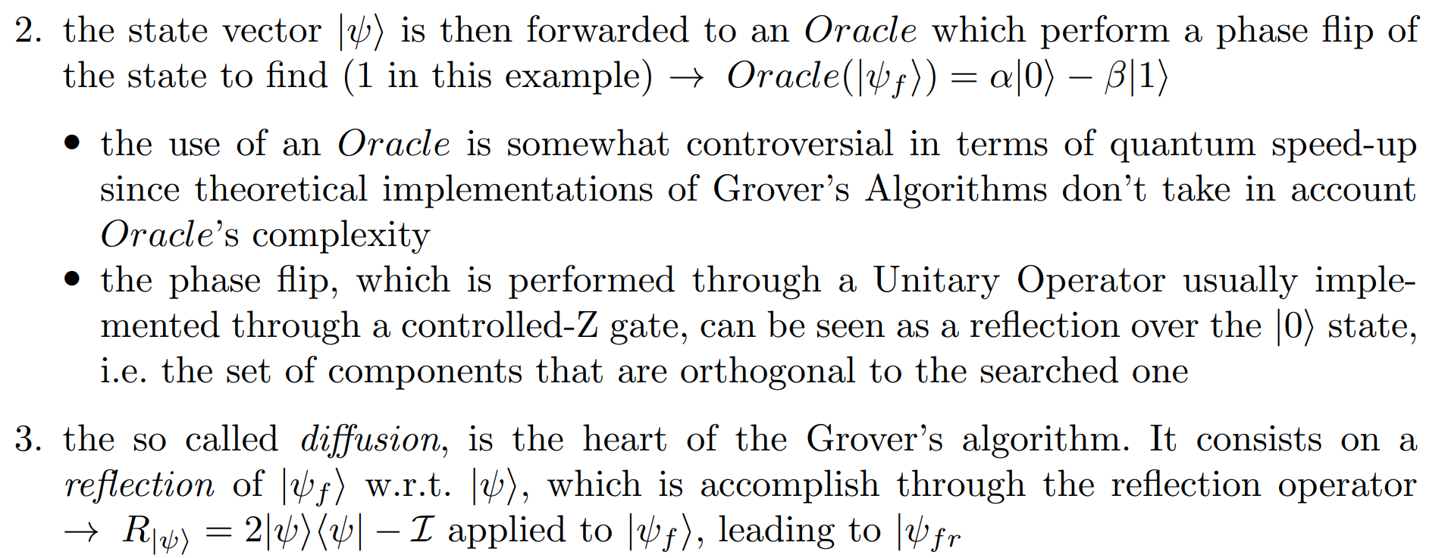
Grover Algorithm - Grover Iteration

Slide 20
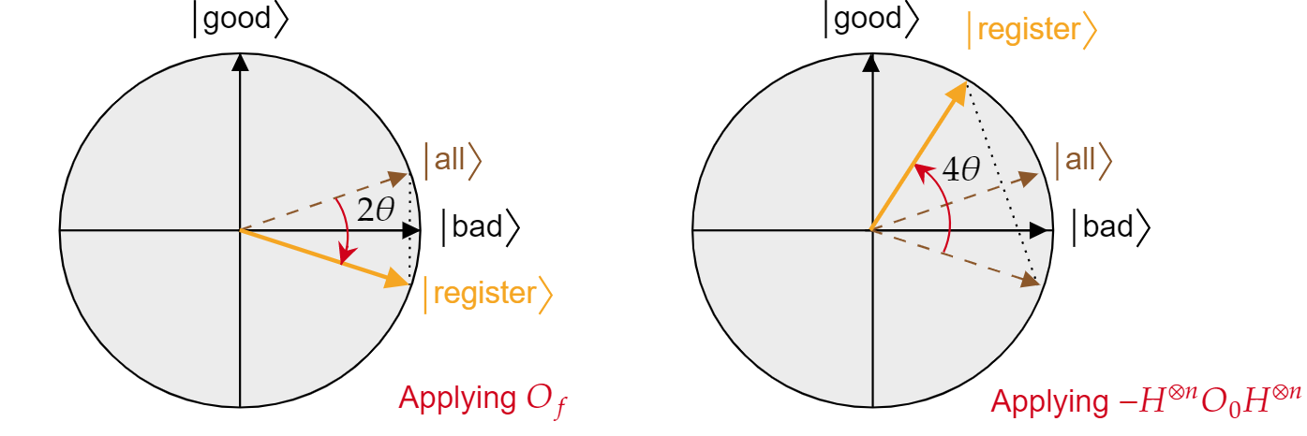
Grover Algorithm - Grover Iteration
2. Oracle
3. Diffusion

Slide 21
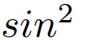
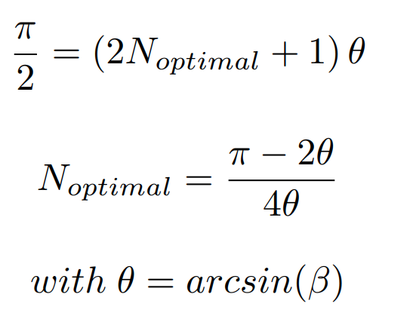
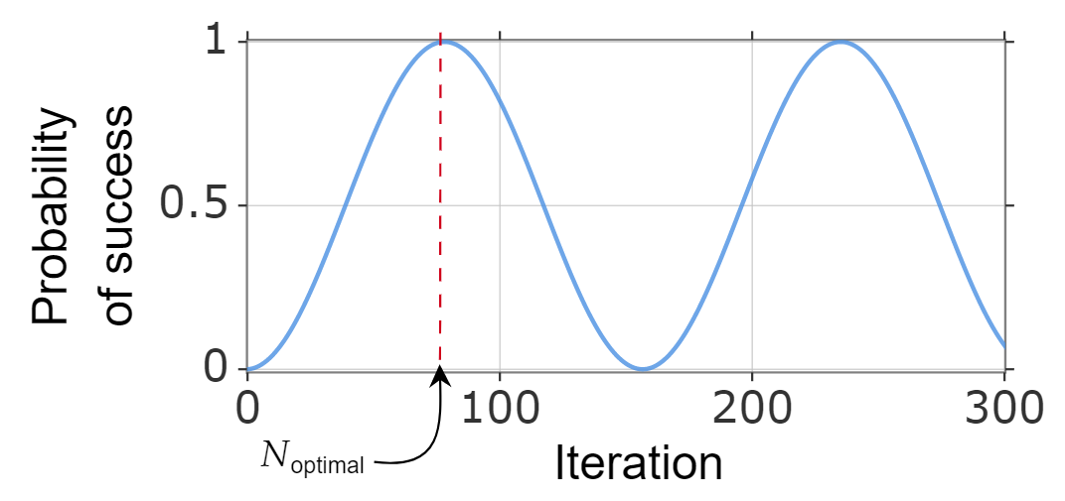
Grover Algorithm - Non Convergence
Since the probability of winning state evolve as a it doesn’t converge to an optimal solution

Slide 22
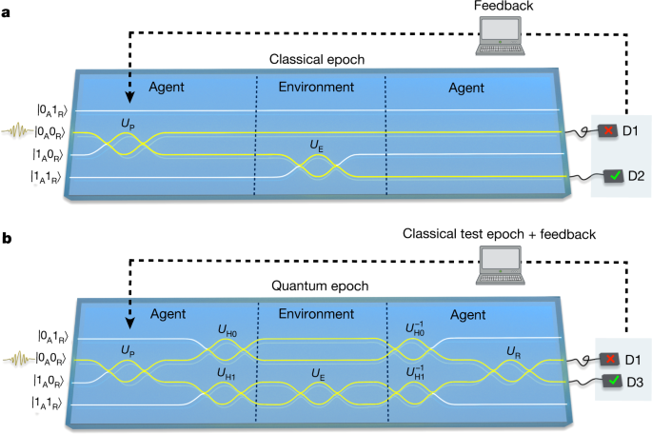
Quantum Enhanced Reinforcement Learning

Slide 23
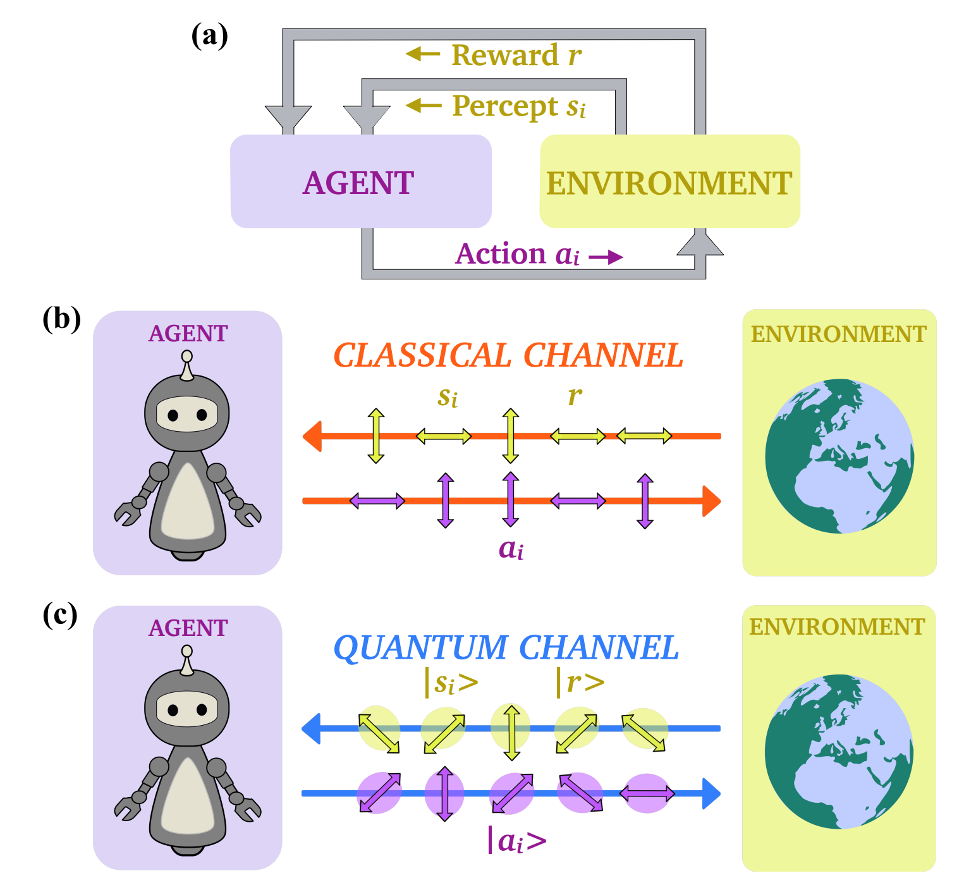
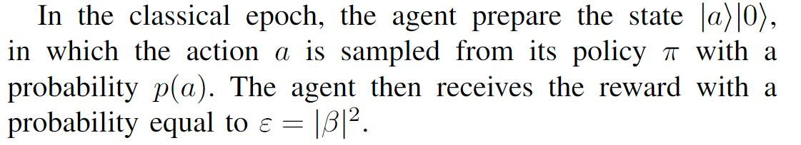
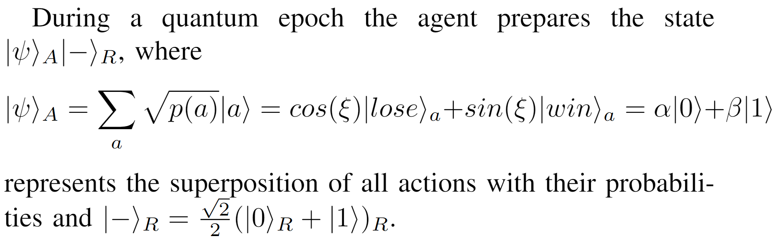
Setting

Slide 24
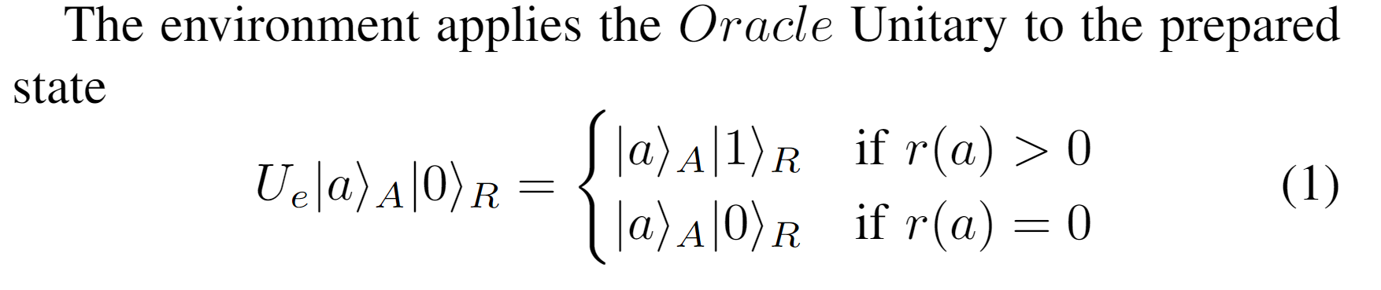
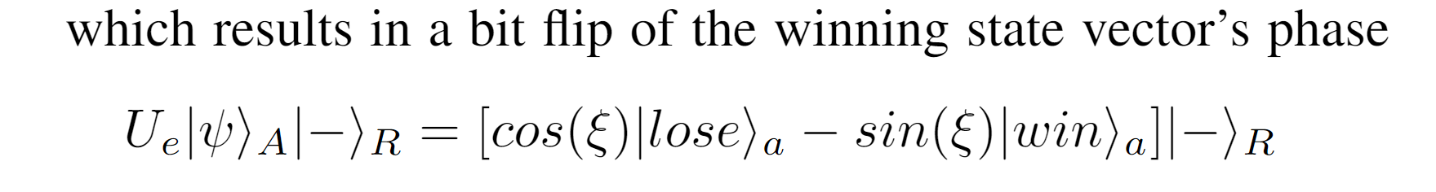
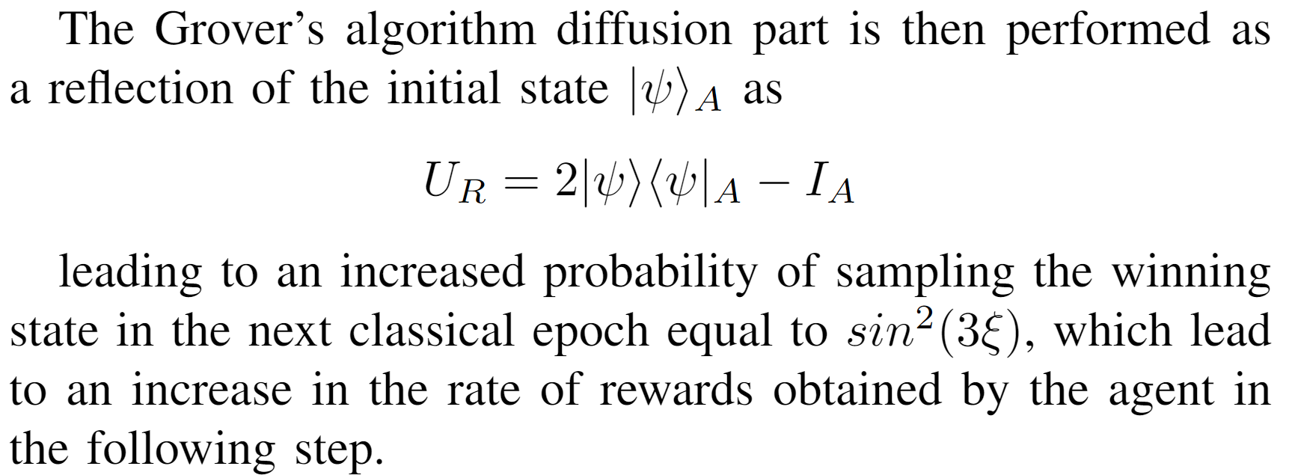
Setting

Slide 25
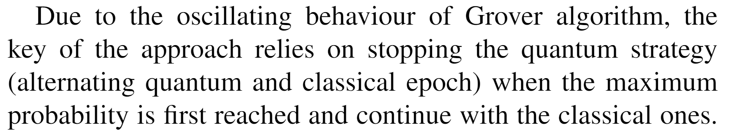
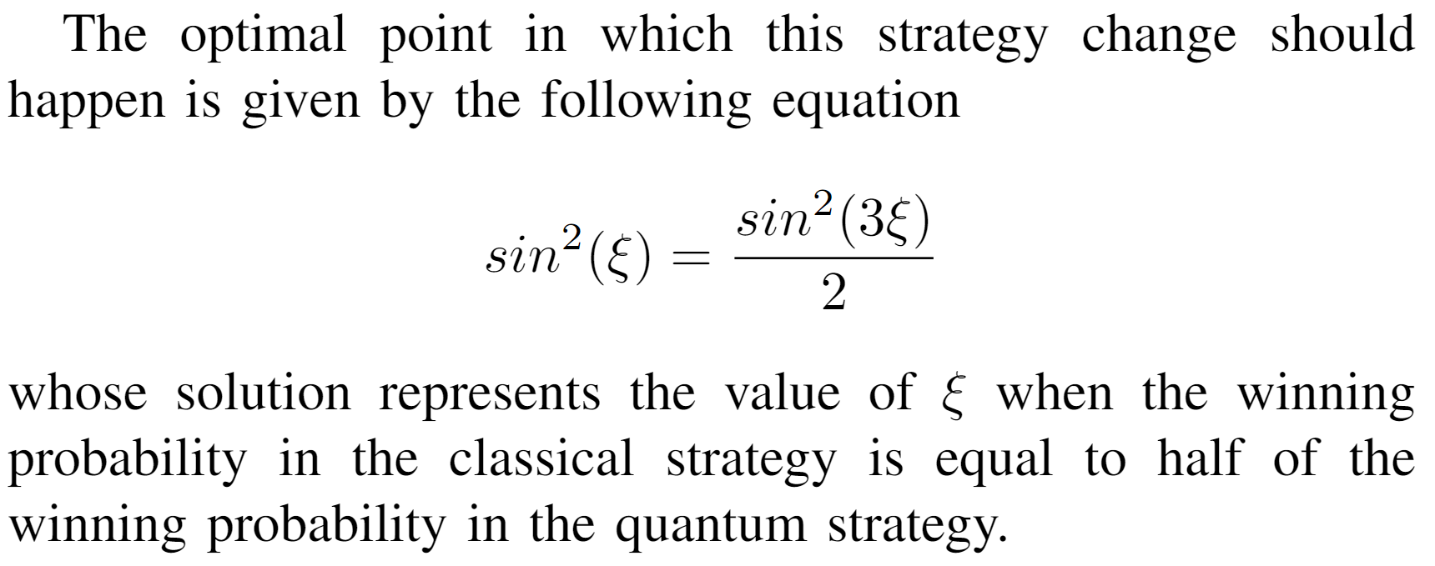
Setting

Slide 26
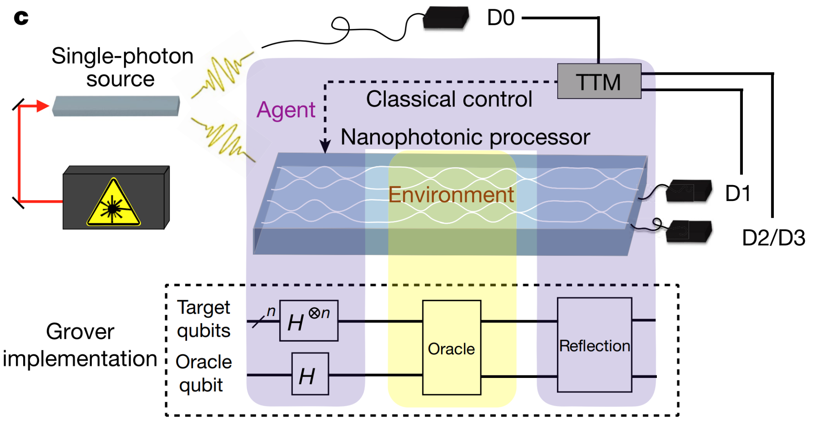
Setting

Slide 27
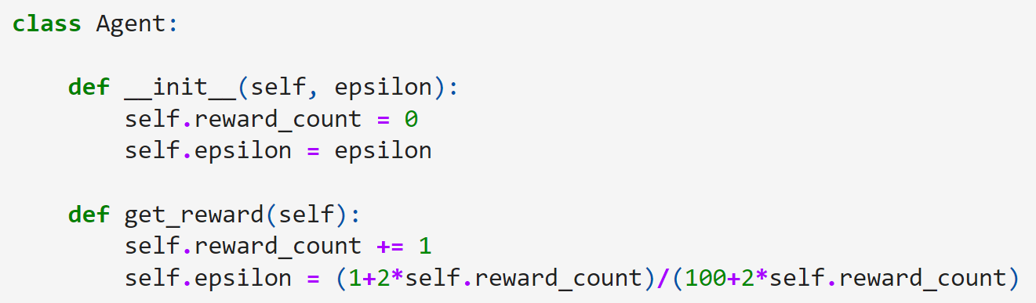
Implementation - Agent

Slide 28
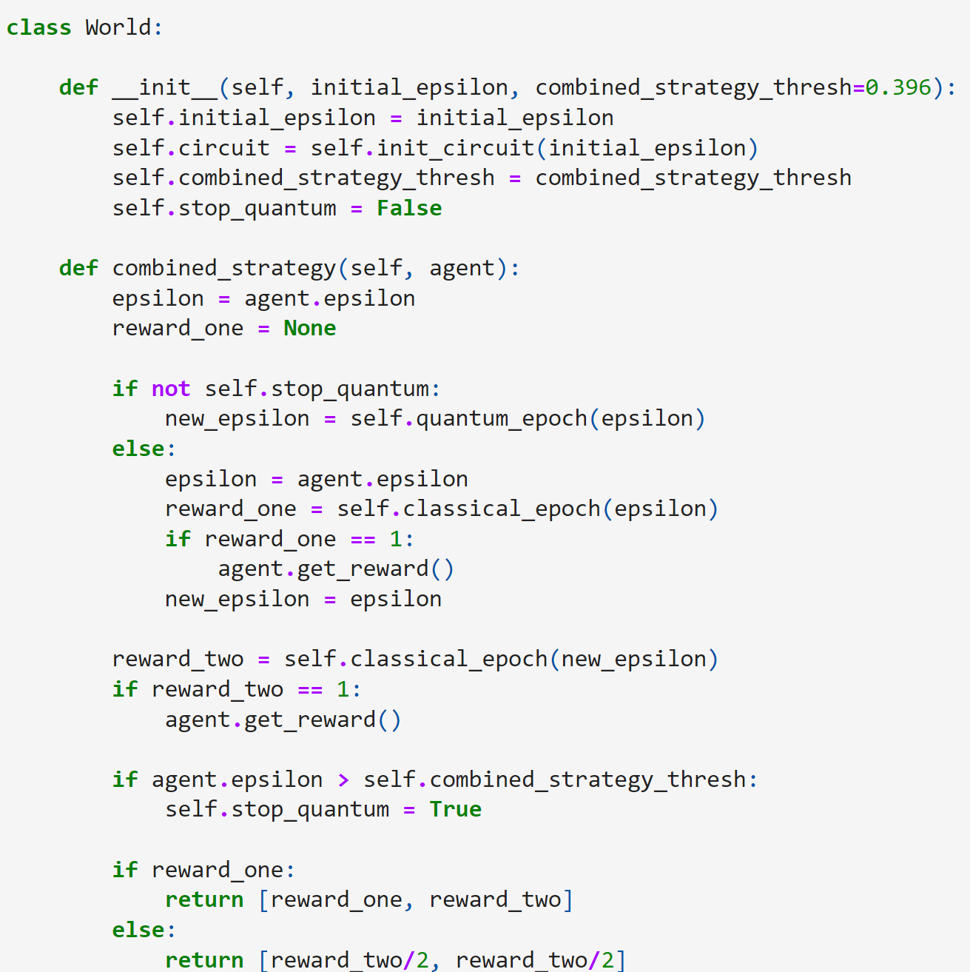
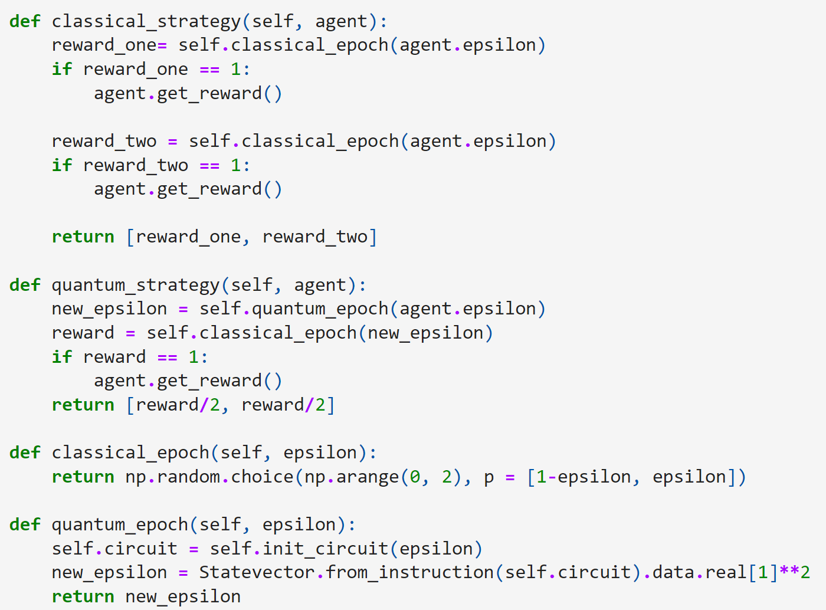
Implementation - World

Slide 29
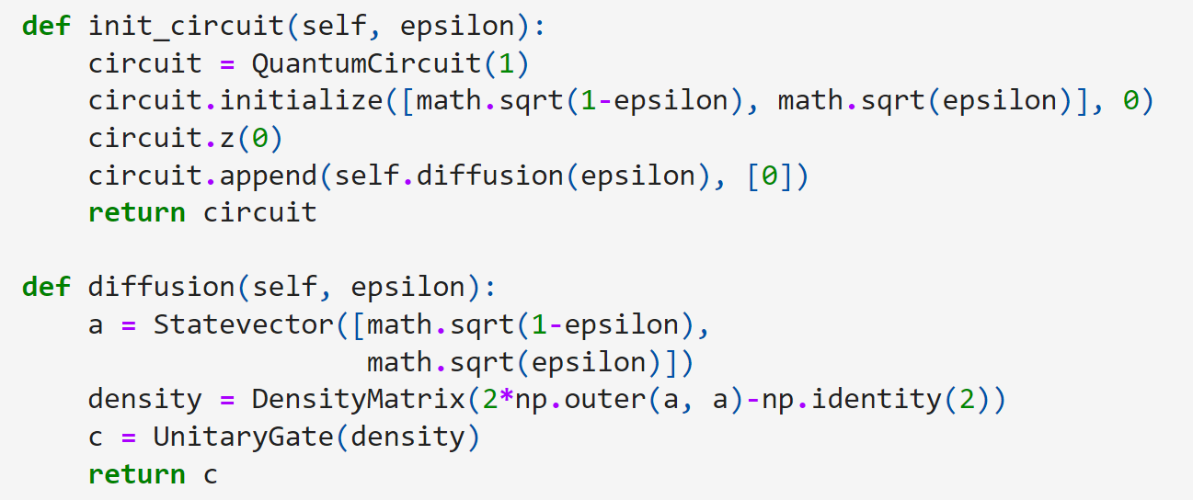
Implementation - World

Slide 30
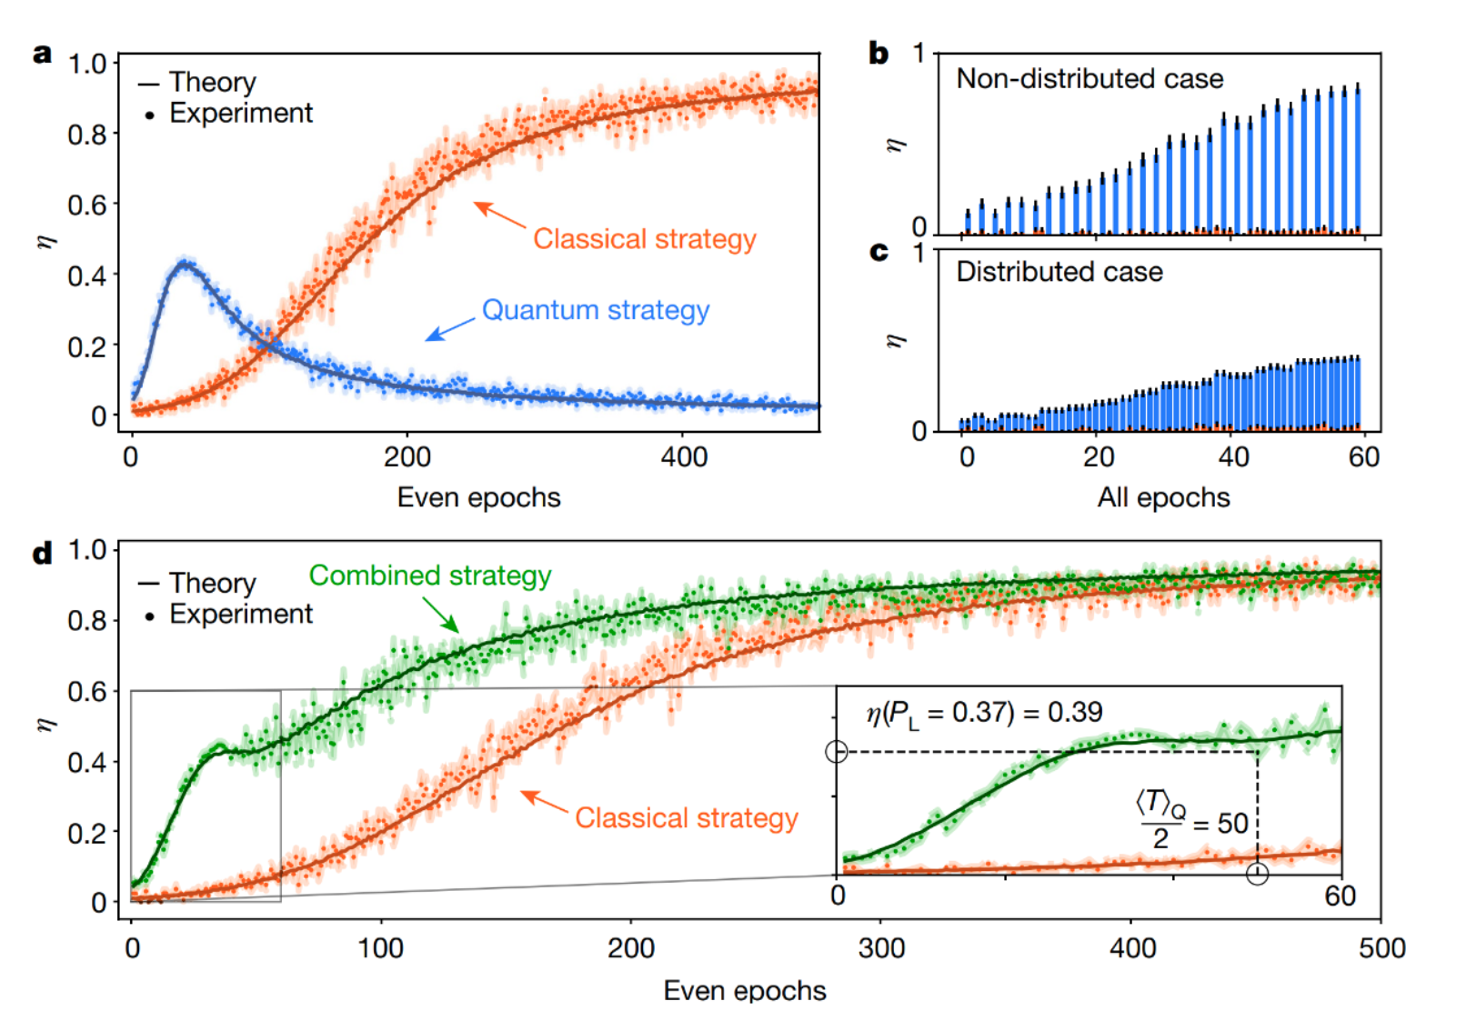
Results - Saggio et al.

Slide 31
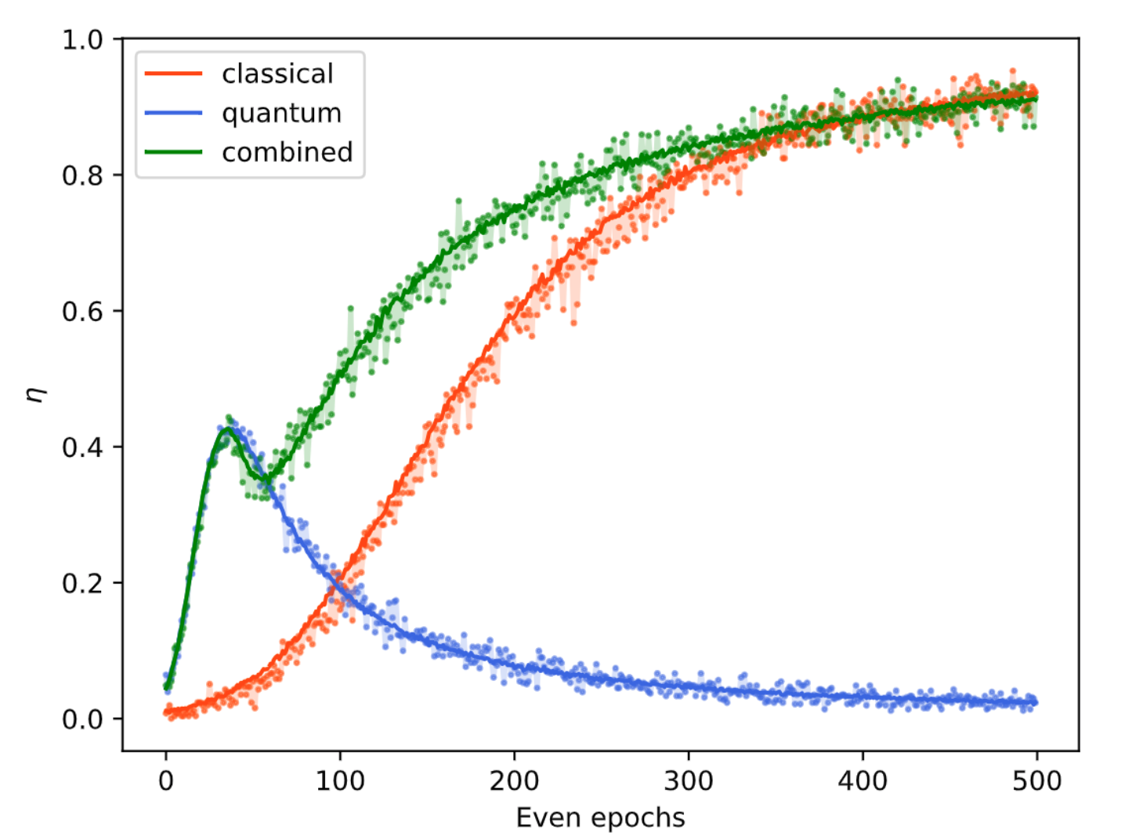
Results - Caldarella

Slide 32
Thank you!
Questions?

Slide 33
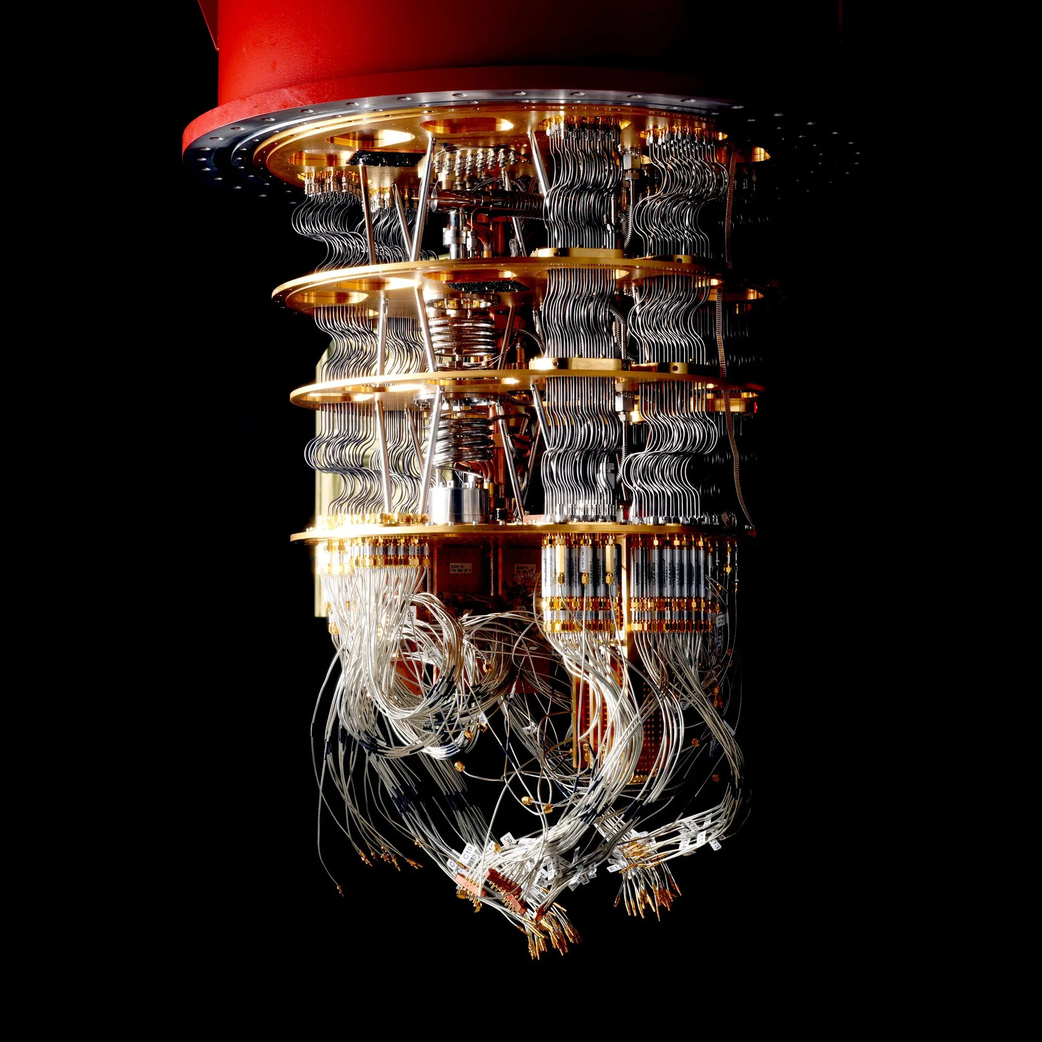
Contact
simone.caldarella@studenti.unitn.it
simone.caldarella98@gmail.com

